Slide 1

Data Structures and Algorithms
Notes on Search

Slide 2
Search
Two basic reasons to search a graph
Find a given node
Explore an entire finite graph

Slide 3
Explore an Entire Graph
This is “classical search”
To discover its properties
Find shortest paths from one node to all other nodes
Find shortest paths from every node to every other node
Find out if the graph is connected
Or at least find the connected subgraphs

Slide 4
Find a Given Node
Often we are not given an algorithm to solve a problem, but only a specification of what is a solution — we have to search for a solution.
A typical problem is when the agent is in one state, it has a set of deterministic actions it can carry out, and wants to get to a goal state.
Many AI problems can be abstracted into the problem of finding a path in a directed graph.
Often there is more than one way to represent a problem as a graph.

Slide 5
Example Crossword Puzzle
1 |  | 2
3
 |  | 4
Consider a crossword puzzle in which you are given a list of words to fit into the numbered words that go across and down.
Admittedly, this is an unusual form of crossword puzzle.
Such a puzzle could be represented as a graph in at least two ways.
Each node could be a word, with the edges giving the relationships between each word.
Each node could be a square, with the edges connecting legal letters in the rest of the word.
We’ll discuss this more under Constraint Satisfaction Problems.
Words: ant, big, bus, car, has, book, buys, hold, lane, year, beast, ginger, search, symbol, syntax

Slide 6
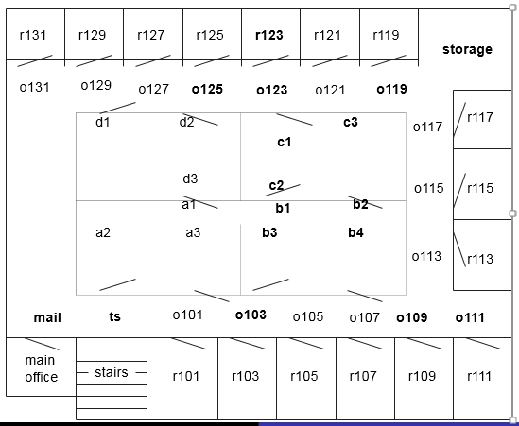
Example Problem for Delivery Robot
The robot wants to get from outside room 103 to the inside of room 123.

Slide 7
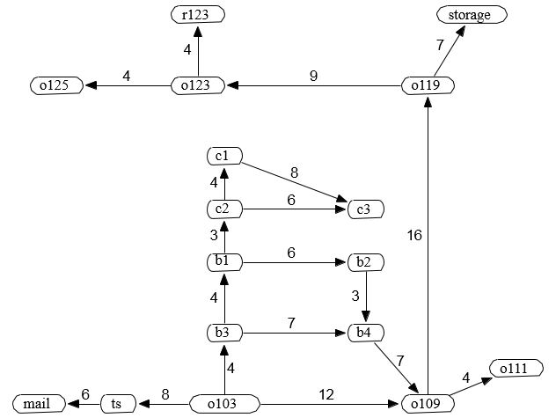
State Space Graph for Delivery Robot

Slide 8
Graph Searching
Generic search algorithm: given a graph, start nodes, and (optionally) goal nodes, incrementally explore paths from the start nodes.
Maintain a frontier of paths from the start node that have been explored.
As search proceeds, the frontier expands into the unexplored nodes until a goal node is encountered, or until the graph is exhausted.
The way in which the frontier is expanded defines the search strategy.

Slide 9
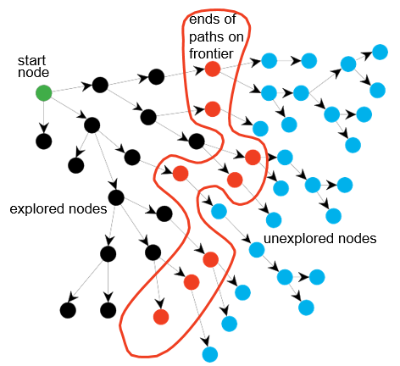
Problem solving by Graph Searching
Red nodes = Gray nodes
Blue nodes = White nodes

Slide 10
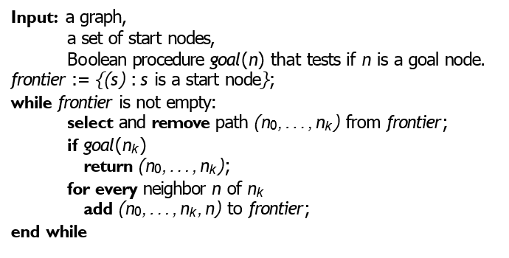
Generic Graph Search Algorithm

Slide 11
Keeping track of the path
You remove a “path” from the frontier because you want to keep track of the way you got to the node.
One way to do this is to maintain a “predecessor matrix” (later).
Sometimes you don’t need to store paths, only know which nodes have been visited.
You’re exploring an entire graph.
You want to find the node for its value, you don’t care how you got there.

Slide 12
Graph Searching
Which value is selected from the frontier at each stage defines the search strategy.
The neighbors define the graph.
The goal (if any) defines what is a solution.
If more than one answer is required, the search can continue from the return.
Maybe you want to find all goal nodes.

Slide 13
Breadth-First Search (BFS)
Breadth-first search treats the frontier as a queue.
In always selects one of the earliest elements added to the frontier.
If the list of paths on the frontier is [p₁, p₂, …, p_{n}]:
p₁ is selected. Its neighbors are added to the end of the queue, after p_{r}.
p₂ is selected next.

Slide 14
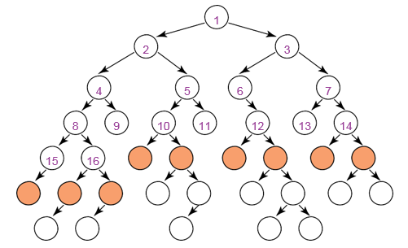
Illustrative Graph – Breadth-first Search
Assuming that when we have a choice, we always go left.

Slide 15
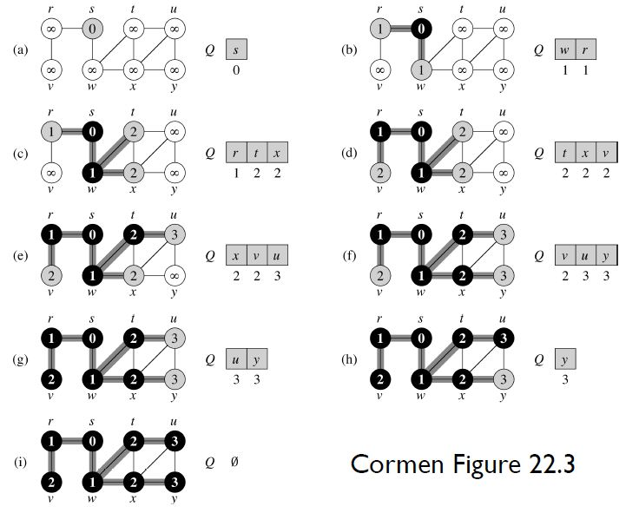
BFS example #1

Slide 16
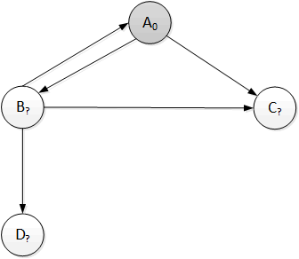
BFS Example #2: Step a
. Node | Nr. edges from start | Prev Node | Queue after processing node
 |  |  | Node at Head | Nr edges from start | Prev node | Node | Nr edges from start | Prev node | Node | Nr edges from start | Prev node
(init) |  |  | A | 0

Slide 17
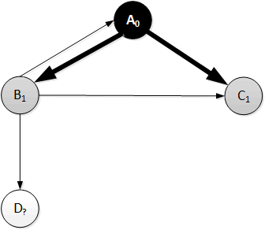
BFS Example #2: Step b
. Node | Nr. edges from start | Prev Node | Queue after processing node
 |  |  | Node at Head | Nr edges from start | Prev node | Node | Nr edges from start | Prev node | Node | Nr edges from start | Prev node
(init) |  |  | A | 0
A | 0 | - | B | 1 | A | C | 1 | A

Slide 18
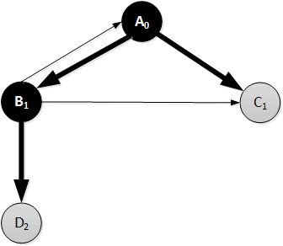
BFS Example #2: Step c
. Node | Nr. edges from start | Prev Node | Queue after processing node
 |  |  | Node at Head | Nr edges from start | Prev node | Node | Nr edges from start | Prev node | Node | Nr edges from start | Prev node
(init) |  |  | A | 0
A | 0 | - | B | 1 | A | C | 1 | A
B | 1 | A | C | 1 | A | D | 2 | B

Slide 19
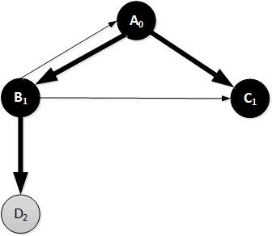
BFS Example #2: Step d
. Node | Nr. edges from start | Prev Node | Queue after processing node
 |  |  | Node at Head | Nr edges from start | Prev node | Node | Nr edges from start | Prev node | Node | Nr edges from start | Prev node
(init) |  |  | A | 0
A | 0 | - | B | 1 | A | C | 1 | A
B | 1 | A | C | 1 | A | D | 2 | B
C | 1 | A | D | 2 | B

Slide 20
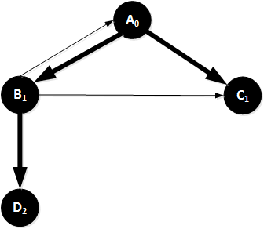
BFS Example #2: Step e
. Node | Nr. edges from start | Prev Node | Queue after processing node
 |  |  | Node at Head | Nr edges from start | Prev node | Node | Nr edges from start | Prev node | Node | Nr edges from start | Prev node
(init) |  |  | A | 0
A | 0 | - | B | 1 | A | C | 1 | A
B | 1 | A | C | 1 | A | D | 2 | B
C | 1 | A | D | 2 | B
D | 2 | B

